Slide 1

Embedded Systems Development Laboratory
525.743
Jeff Houser
(301) 394-0797
jghouser@gmail.com

Slide 2
Introduction
Embedded system prototype development
  Concept development
  Requirements
    Capabilities
    Limitations
  Team development strategies (if applicable)
  Development plan including
    Schedule
    Resource requirements
    Implementation strategy
    Interface design
  Reporting
  Documentation
Topics not covered
  Programming, electrical design, or computer design
  Production or manufacturing related topics
Spr 2018

Slide 3
Expectations
700 level course requires independence
  Investigate your design
  Develop outside of class
  Report on your progress
  Advise of roadblocks and develop alternate path
  Document your work
Correspondence
  Must be conducted within Blackboard
  Use my work contact to get my attention, if needed
Attend class
  Advise of absences due to travel
Step out of your comfort zone and try something new
  I’ll help you manage risk
  You won’t get fired if the project isn’t perfect
I should not wonder how you’re doing –
Keep me in the loop!
Spr 2018

Slide 4
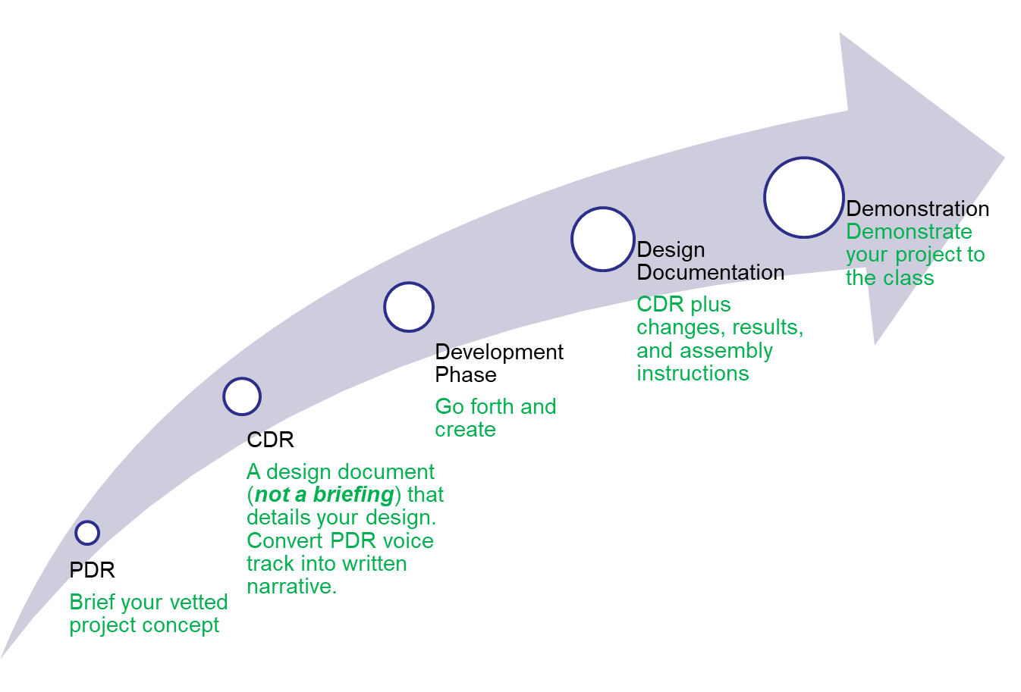
Documentation Scheme
Spr 2018

Slide 5
Project Topic
Should be of interest to
  You, or
  Your employer, or
  Me if you can’t think of anything (this is ok!)
Must meet course requirements
  I’ll work with you to ensure scope is appropriate
Individual or team play
  Up for discussion
  Small teams encouraged
Must be resourced
  Material
  Development tools
  Skill set
Kit building not ok, but mods and enhancements are
Virtually all Project Topics Welcome
Spr 2018

Slide 6
Grading Criteria/Course Schedule
20% Preliminary design review
25% Critical design review
35% Development
        Requires weekly status updates
20% Documentation
Project demo
Spr 2018

Slide 7
Introductions: about me
Education
  U.S. Navy, BSEE UMD, MSEE JHU
U.S. Navy Fire Control Tech.
  Radar, computers, electronics, displays, servos, swabbing, painting, …
Vitro Corp
  Surface to air missile fire control software
NASA/GSFC
  Design of instrumentation to support scientific investigations
  Ground based, sub-orbital, LEO, and planetary missions
  Magnetometers, electric field, gamma & x-ray spectrometers, high voltage, wide-band radio astronomy
U.S. Army Research Laboratory
  Sensors for military applications
Hobbies
  Road Cycling
  Amateur radio (operation, design, low power techniques)
Spr 2018

Slide 8
Introductions: about you
Name
Education
  Undergrad
  Graduate
  Other
Employer
Interests
Are you taking other classes?
What do you want out of this course?
Spr 2018

Slide 9
Generic Project
Some type of embedded processor
One or more inputs
  Sensors
  Commands or data from others systems
Some type of processing
  Algorithms anyone?
Generate an output
  Wired or wireless comms
  Display
  Actuator
    launch a Nerf missile or bring me a beer
    Control a robot
Spr 2018

Slide 10
Brain Storm
Spr 2018

Slide 11
Assignment
Develop topic for your project
  Primary
  Alternate
Should include
  Functional description
  Implementation
  Resource requirements
  Development plan
  Rough interface description
Project Concepts Presented on 3rd Class Meeting!
Spr 2018

Slide 12
Resources
Component distributors
  http://www.digikey.com
  http://www.sparkfun.com/
  http://www.pololu.com/
Processors (just a few)
  http://www.arduino.cc/
  Android & iOS
  http://beagleboard.org/
  http://www.ti.com/lsds/ti/microcontroller/home.page
  http://ics.nxp.com/lpcxpresso/
Spr 2018

